Slide 1


Insight into LOCKBIT
By: Karla Alvarez

Slide 2


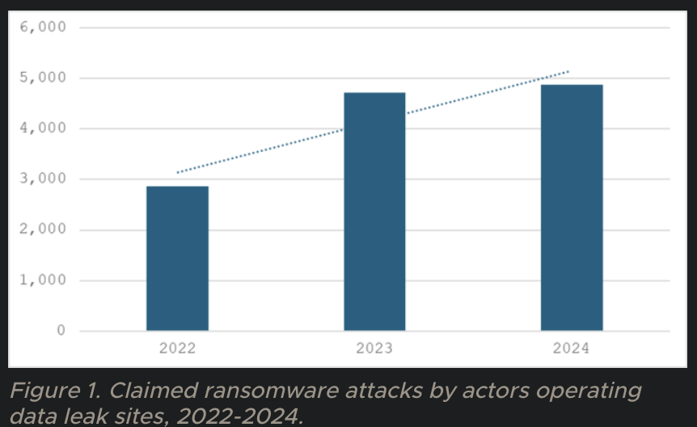
Ransomware
Malicious software that encrypts files, demanding payment for decryption
Ransomware attacks continued to trend upwards in 2024, rising by 3% compared to 2023
https://www.security.com/threat-intelligence/ransomware-trends-2025

Slide 3

Who is Lockbit?
A ransomware-as-a-service (RaaS) first identified in September 2019
Their motive is primarily financial gain through ransom payments
2020
2021
2022
2023
The name ‘LockBit’ emerged, and the group created its on website, with posts in Russian and English (although it claimed to be based in the Netherlands)
LockBit 2.0 was launched, including a feature called StealBit, an infostealer that could disguise itself to gather sensitive data
LockBit operators claimed responsibility for cyberattacks on many organizations with a ransom demand of $60 million—and launched LockBit 3.0.
French-based brand Nuxe claimed to have been targeted by LockBit attacks, along with the UK’s Royal Mail, and countless more.

Slide 4
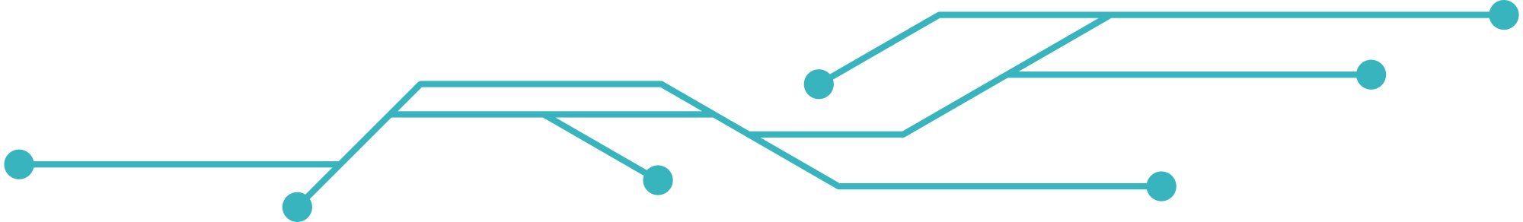
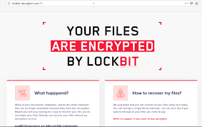

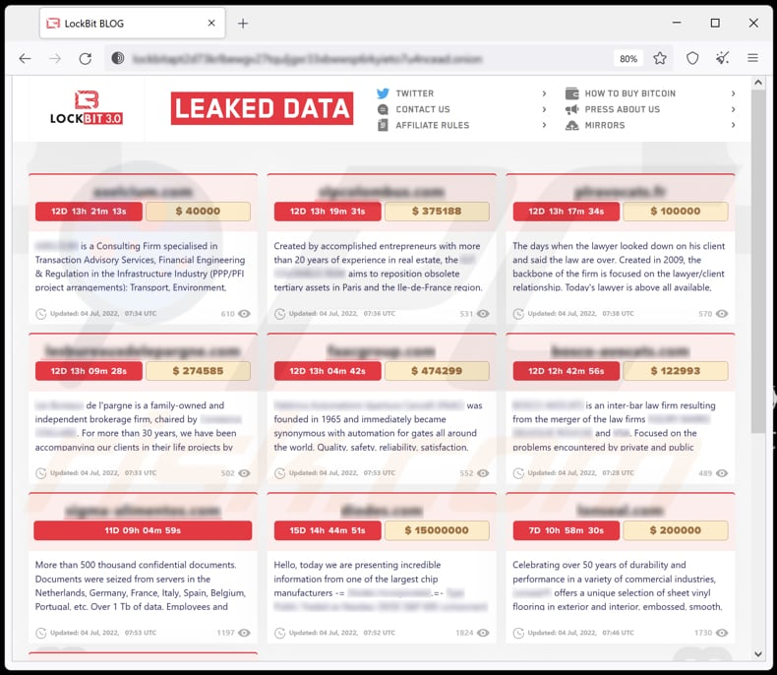
Let’s get serious..
What makes them dangerous?
Ransom Demands: Victims pay $40,000 on average
Double Extortion: "Pay us, or we’ll leak your files online!"
Affiliate Program: Hackers earn 80% of ransoms they collect

Slide 5



HOW IT
Initial Access
WORKS
LockBit’s software relies on tools including PowerShell Empire and Cobalt Strike, as well as abusing the Windows Defender tool. These systems allow it to move through victims’ networks—and delete log files and backups before the attack.
Lateral movement and Privilege Escalation
Ransomware payload is deployed

Slide 6

NOTABLE DEVELOPMENTS
LOCKBIT VERSIONS
LockBit 1.0
Release: September 2019
Features:
Operated as Ransomware-as-a-Service (RaaS).
Strong encryption of victim files.
Self-propagation in networks.
Targeted mainly smaller organizations.
Basic ransom notes detailing payment instructions.
LockBit 2.0
Release: July 2021
Enhancements:
Improved encryption speed.
Introduced data exfiltration capability (theft of data before encryption).
Online negotiation platform for ransom discussions.
Broadened target scope, including mid-sized and larger businesses.
More sophisticated ransom notes.
LockBit 3.0
Release: Early 2022
Notable Features:
Enhanced RaaS infrastructure for affiliates.
Better code quality and execution speed.
Customizable ransom notes and targeted attacks.
Multi-language notes to engage a global audience.
Strengthened data leakage threats against victims.

Slide 7
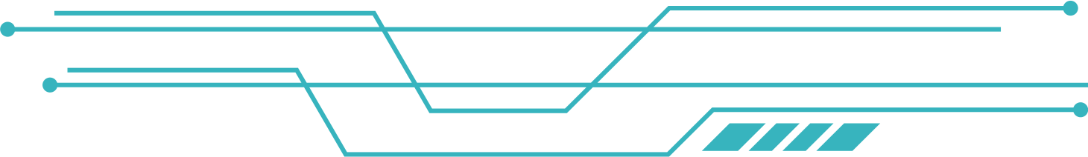
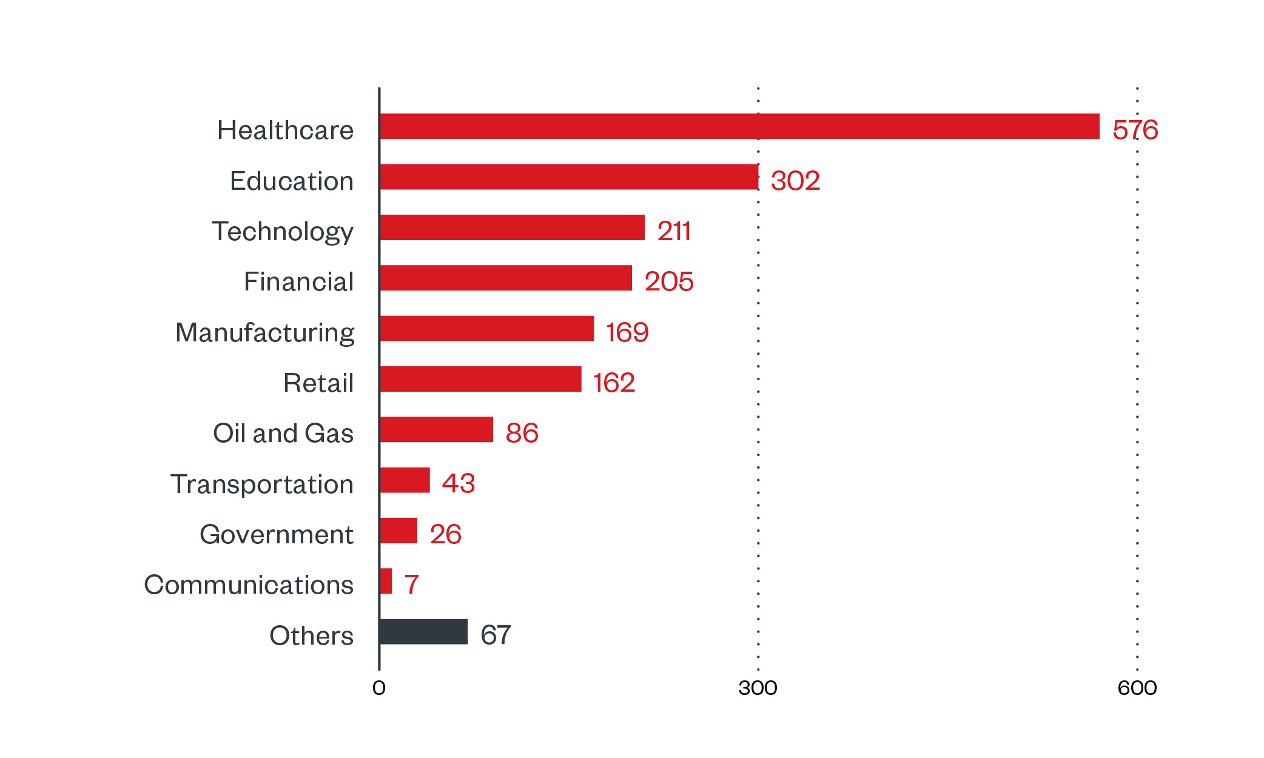
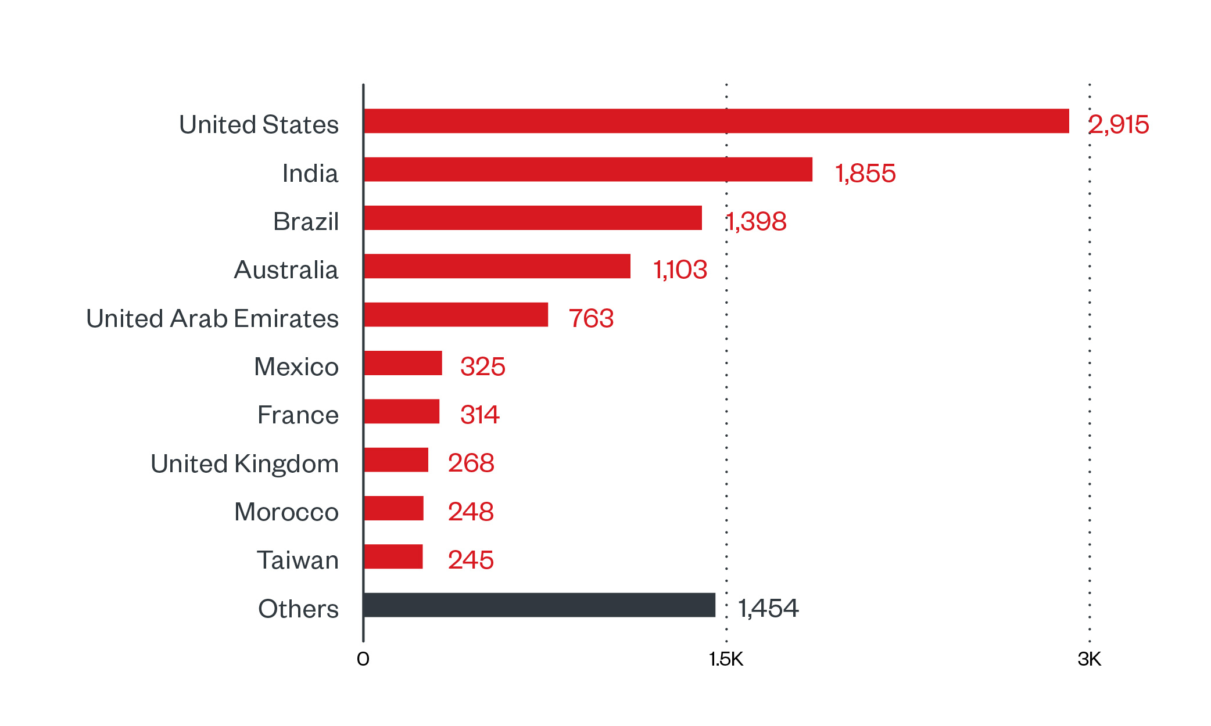
LockBit
Targets

Slide 8
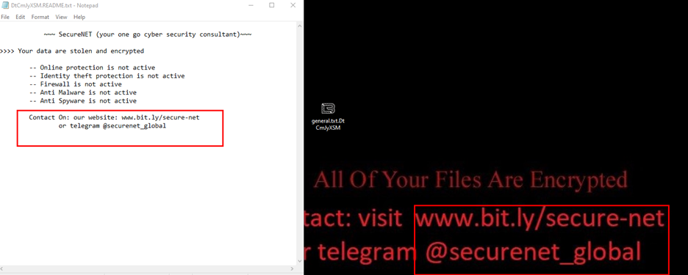
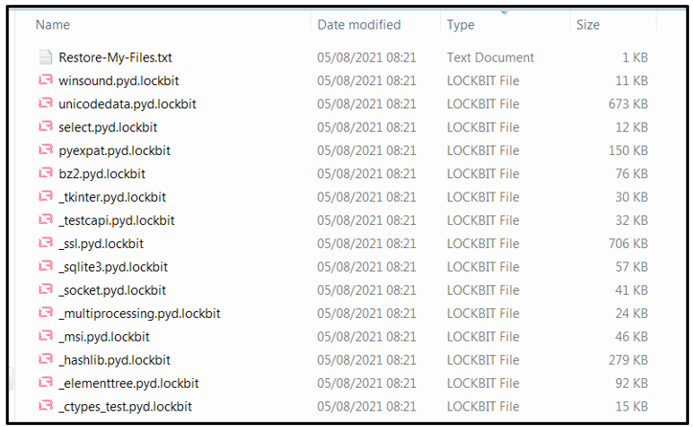
How to Spot LockBit
Warning Signs:
Files renamed to ".lockbit".
Pop-up ransom notes on your screen.
Slow computers or missing files.
Source: CISA (Cybersecurity Agency) guidelines 11.

Slide 9
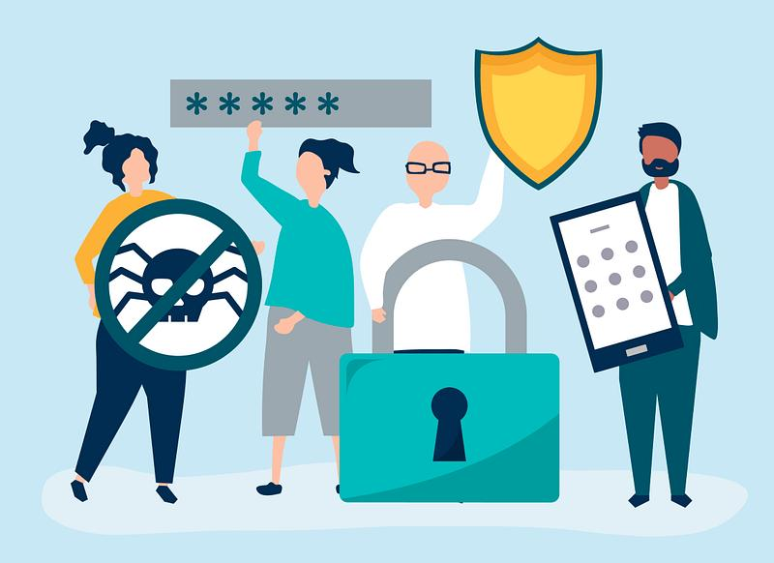



HOW TO PROTECT AGAINST
LOCKBIT RANSOMWARE
Strengthen Access Controls
Mandate Multi-Factor Authentication (MFA): Apply MFA to all public-facing services (e.g., VPNs, RDP) to block credential-based attacks 1813.
Enforce Strong Passwords: Use 15+ character passwords with symbols/numbers; avoid reusing credentials
Employee Training
Phishing Simulations: Train staff to recognize malicious emails (common LockBit entry point)
Incident Reporting: Establish clear protocols for reporting suspicious activity
Patch and Update Systems
Automate Updates: Ensure OS, software, and firmware updates are applied promptly

Slide 10

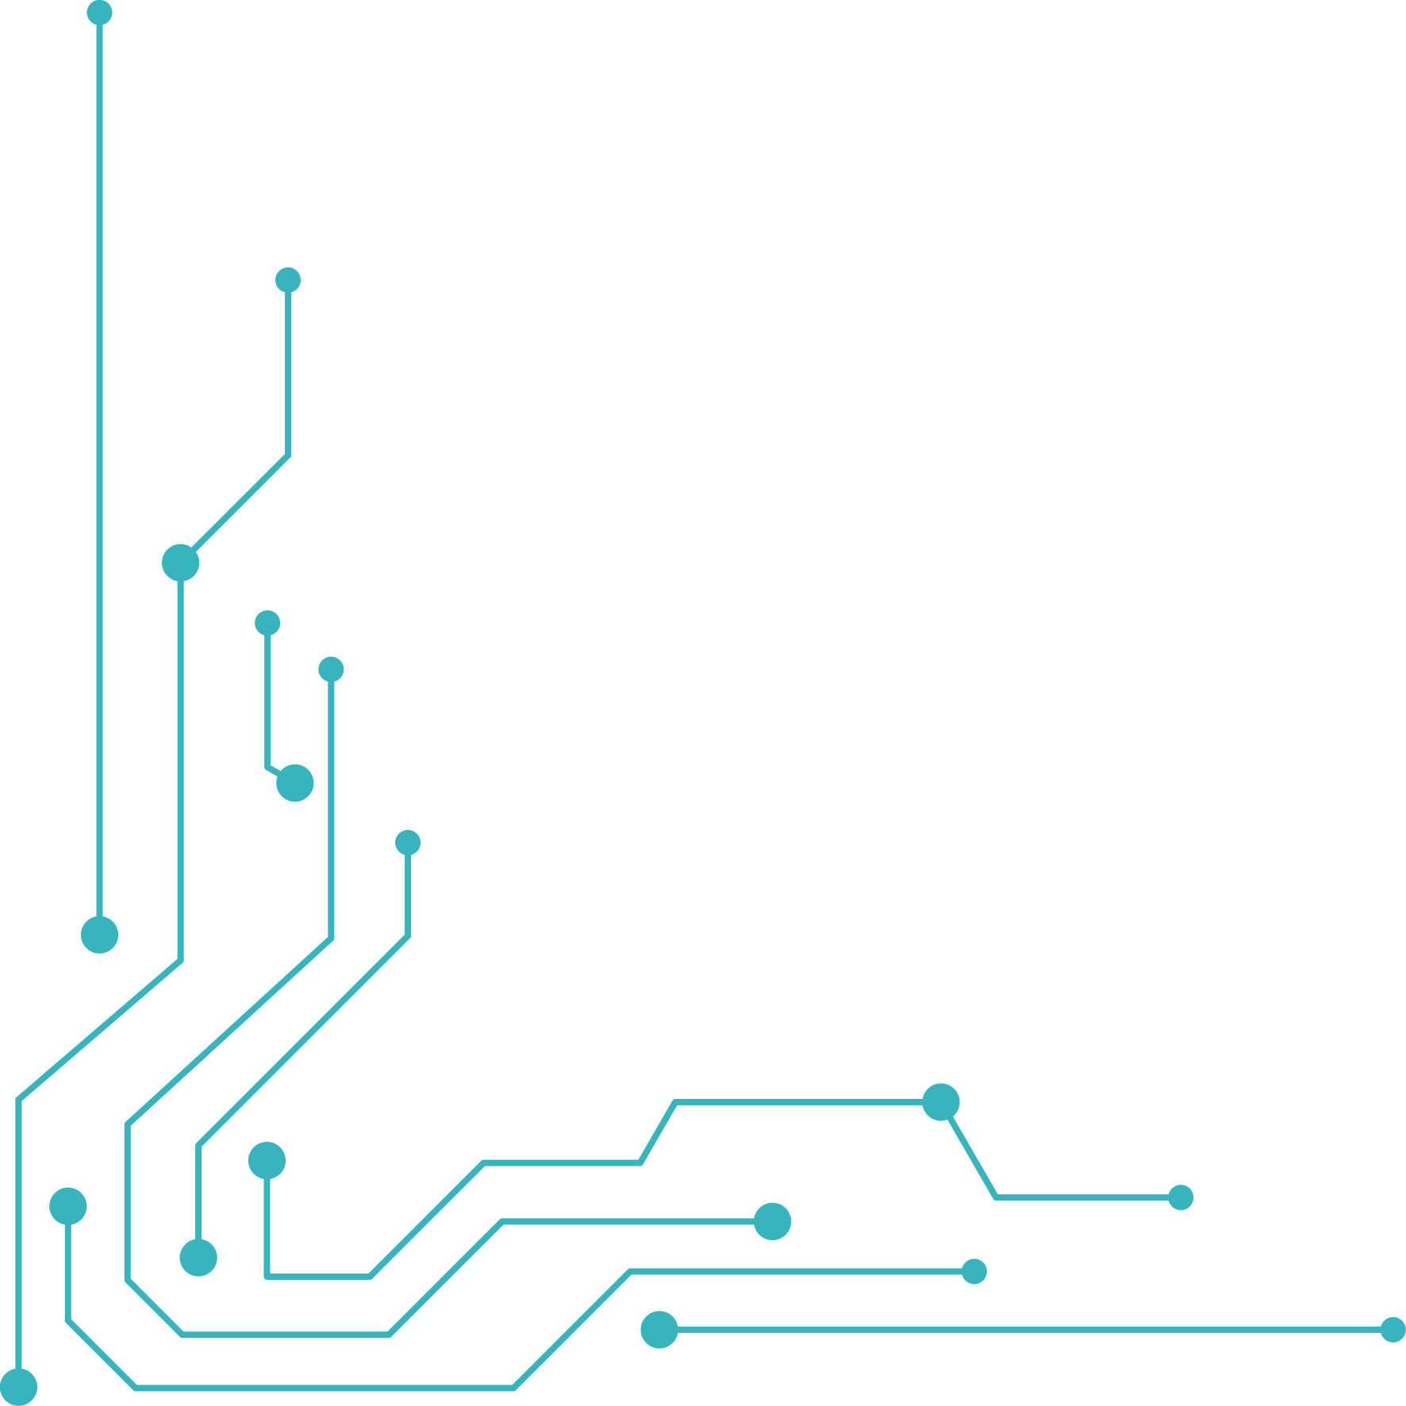
THANK YOU
Sources
https://www.trendmicro.com/vinfo/us/security/news/ransomware-spotlight/ransomware-spotlight-lockbit
https://www.akamai.com/glossary/what-is-lockbit-ransomware
https://www.state.gov/reward-for-information-lockbit-ransomware-as-a-service/

